Slide 1
Predators, Prey and Competition

Slide 2
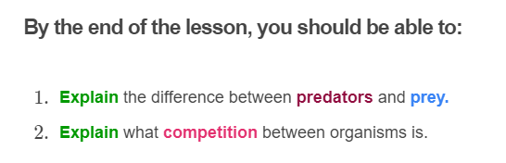
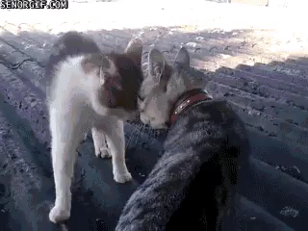

Slide 3
Did you know that all the organisms in an ecosystem are connected through the wonderful circle of life?

Slide 4
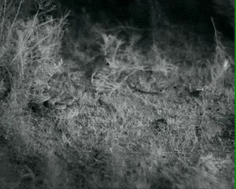
So, what's the difference between a predator and prey?
Predators are animals that eat other animals.
Prey are the animals eaten by predators.
In the gif below, the snake (predator) tries to catch the mouse (prey).

Slide 5


Slide 6
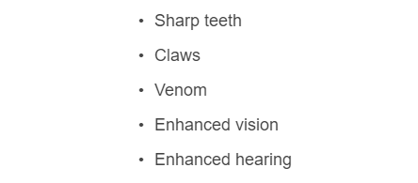
Predators have evolved special features, called adaptations, to enhance their ability to find and catch food.
Some examples of predator adaptations include:

Slide 7
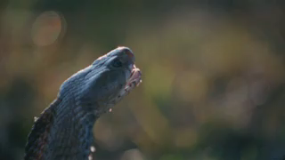
For example, some snakes are able to inject venom into their prey.
Venom works to paralyse the prey so that the snake can kill it faster.

Slide 8
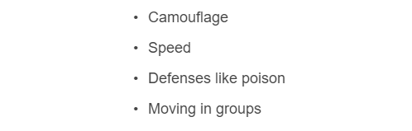
Prey species exhibit adaptations that help them avoid detection or capture by predators.
Some examples of adaptations used by prey include:

Slide 9
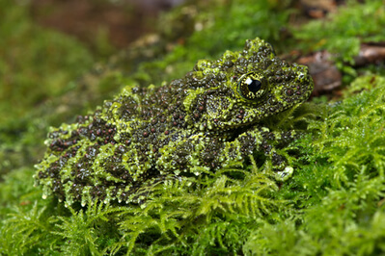
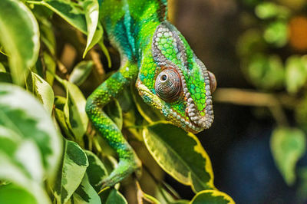
For example, some moths, frogs and lizards use camouflage to blend in with their surroundings.
Camouflage reduces the chance of predators spotting the prey!

Slide 10
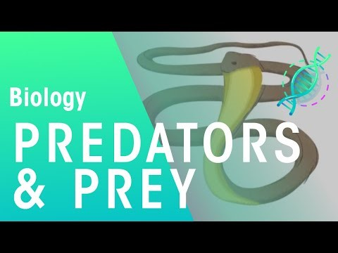

Slide 11
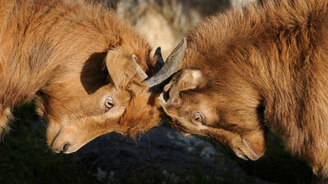
Predator-prey relationships are not the only way that organisms can interact.
Competition is the interaction between two or more organisms that want the same thing. Organisms can compete for things like food, abiotic factors, territory and mates.

Slide 12
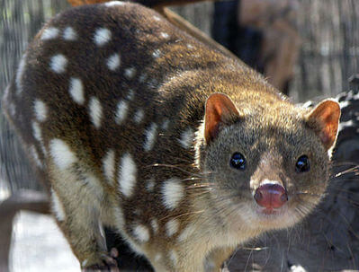
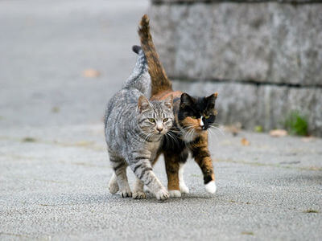
Sometimes, different species of animals can compete for resources that they both need.
In Australia, tiger quolls and feral cats compete for the same type of food. Both species like to hunt small mammals, birds and reptiles.

Slide 13
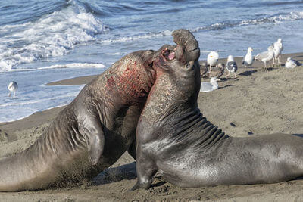
Animals of the same species can also compete for resources.
Male elephant seals compete with each other for access to territory and mates. The male who wins the fight has access to more breeding opportunities.

Slide 14
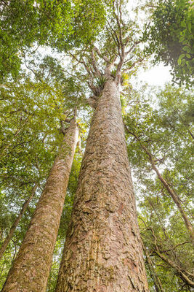
Organisms don’t always have to fight to compete for resources.
For example, plants compete with each other for light. They grow as fast as they can towards the light, while trying to overshadow the other plants in the area!

Slide 15
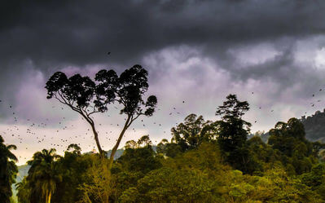
In dense tropical rainforests, there is a fierce competition for sunlight.
The taller, older trees that have established a spot in the forest shadow the ground. They form a green roof over the forest below. This roof is like an umbrella or canopy, and it ensures that the smaller trees will have restricted access to sunlight.
If the smaller trees do not receive enough light, they will not grow properly.

Slide 16
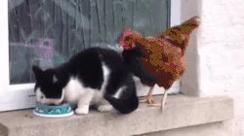
Plants and animals that are the best suited to their environment are likely to be the most competitive.
This means that they can outcompete other organisms for the best resources, like food, territory or light.

